Slide 1
Biology Class Basics
By: Mr.Hajjarian and Mr.Jones

Slide 2
How do I know what to do?

Slide 3
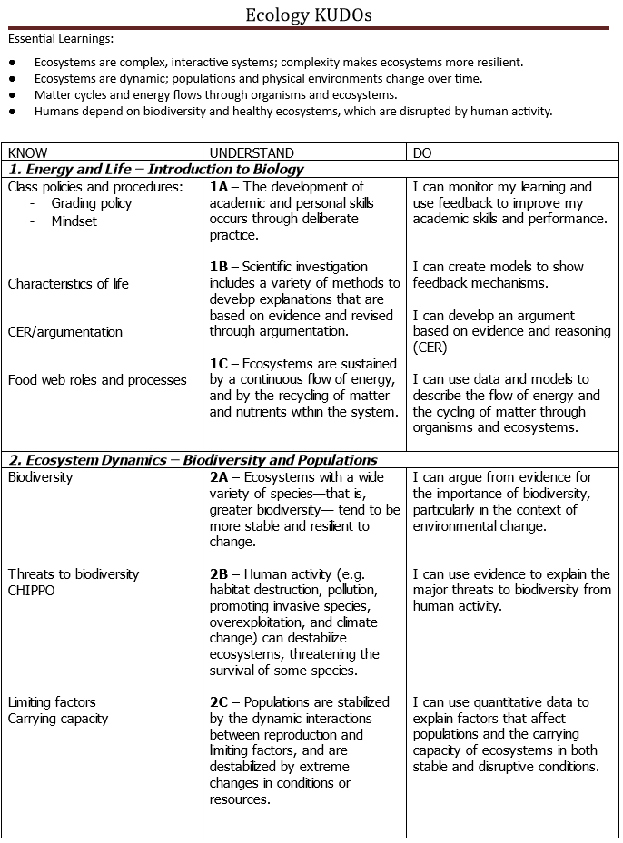
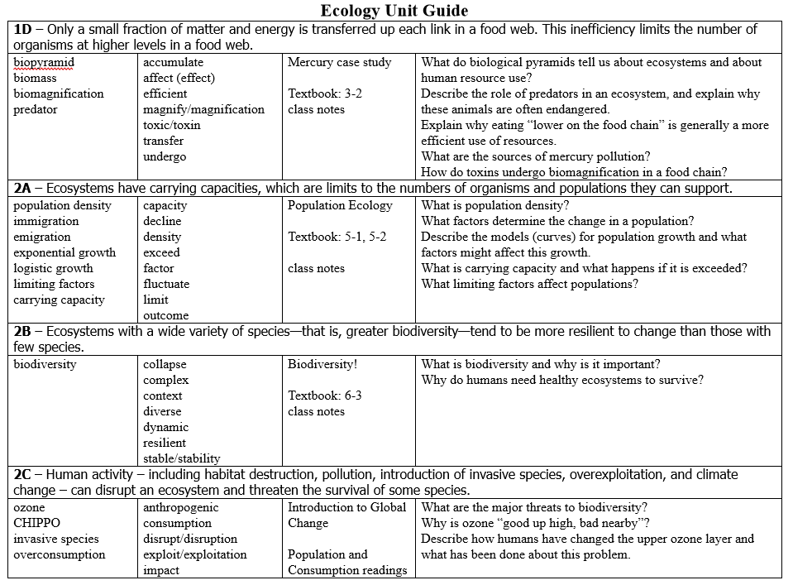
1
Kudos
2
Unit Guides
KUDOS (know, understand and do)
1 page general overview of main topics in the unit
More detailed information about what you need to know
Includes important vocabulary and places to find information about topics
Also has study questions

Slide 4
3
Class Material
4
Ask a Teacher/TA!!
Homework, classwork, lecture notes, review material, etc.
All assignments in class will be preparing you for the unit exams
If you’re not sure send an email or come chat during tutorial/office hours

Slide 5
Assessments and Grades

Slide 6
Assessments and Grades
Formative Assessments (practice tests, CFA’s, homework, etc.)
  Practice
  Do not affect your grade
  Chance for feedback and improvement
Quizzes and Exams
  In the middle or at the end of a unit
  Gives you a grade
    Quizzes are placeholders and the exam at the end of the unit can replace your quiz score
  Can retake exams if you score below an 80%
    Must show homework completion and complete a retake ticket to be eligible
Checkups
  Covers the homework or classwork that was assigned
  Not retakeable or makeupable unless you have an excused absence
  Your lowest 2 per semester will be dropped
Grades are weighted as follows:
Checkups = 15%
Quality Assignments = 20%
Quizzes/Exams = 45%
Final Exam = 20%

Slide 7
Homework
Expect to have approx 15-30 mins of homework per night
  This is based on focused homework time, not multitasking
Homework is not checked or graded directly, however you will be assessed on it via the checkups
If you have spent more than one hour of focused time on an assignment and are still struggling to finish or understand it you can email your teacher and then come to get help during the next tutorial

Slide 8


Note taking skills
Reading comprehension
  Annotation
Writing
  Be clear and concise
Academic vocabulary
  Practice using correct and accurate scientific and academic terminology
Argumentation
  Practice CER style scientific argumentation
Study strategies and test taking skills
Note taking skills
Reading comprehension
  Annotation
Writing
  Be clear and concise
Academic vocabulary
  Practice using correct and accurate scientific and academic terminology
Argumentation
  Practice CER style scientific argumentation
Study strategies and test taking skills
Note taking skills
Reading comprehension
  Annotation
Writing
  Be clear and concise
Academic vocabulary
  Practice using correct and accurate scientific and academic terminology
Argumentation
  Practice CER style scientific argumentation
Study strategies and test taking skills
Academic Skills

